Slide 1

Online Library Management System
Name: Ishani Bhowmick
Roll: 34230921007
Dept: CSE (IOT & CYS including BCT)
Paper: Software Engineering
Paper Code: PECICB601D

Slide 2

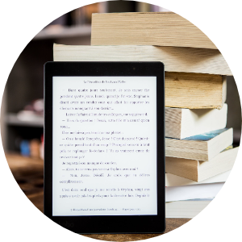


Introduction
A library management system, or LMS, is software that helps libraries with all the tasks they need to run efficiently.
LMS is designed to manage the administration, catalogue, acquisition and circulation of library materials.
They are used in libraries at all levels of size and scale.
It helps in resource sharing with other libraries, accessibility for remote users and more efficient workflow management among others.

Slide 3
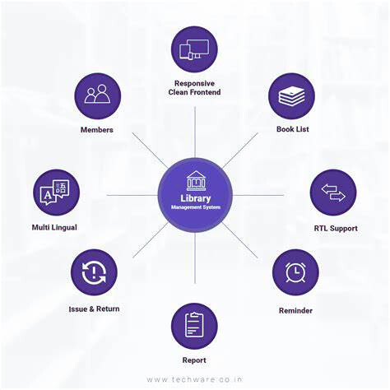

FEATURES
OF
THE SYSTEM

Slide 4


SRS for Library Management System​
The Library Management System (LMS) aims to automate the management of library operations such as book cataloging, inventory management, user registration, book lending, and return processes.
The system will facilitate efficient handling of library resources and improve user experience for patrons and library staff.
It will integrate with existing systems through standard APIs and provide a user-friendly interface for both patrons and library staff.

Slide 5

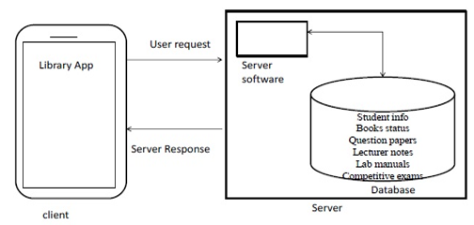
System Architecture for Library Management System​

Slide 6


Hardware and Software Requirement
Hardware interface:​
Operating system : window​
Hard disk :40 GB​
RAM : 256 MB​
Processor : Pentium(R)Dual-core CPU​
Software interface :​
Java language​
Net beans IDE 7.0.1​
MS SQL server 2005​​

Slide 7



FUNCTIONAL REQUIREMENTS​
Login Module:​
Input : Admin enters the Login Id and password.​
Processing : Checks login Id and password is valid or not.​
Output : Admin is directed to next page where he can add, delete or update the products.​
Books:​
Input : Book Details are entered.​
Processing : The book details which we have entered will be stored.​
Output : book details will be displayed when ever member will come for book request.
​
Member Management:​
Input: Admin Enters the details of the person who wants to be member in Library​
Processing: Member details will be stored.​
Output: Membership is issued.​​

Slide 8

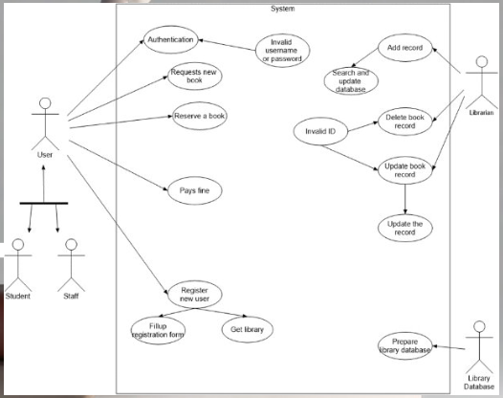
USE CASE DIAGRAM

Slide 9
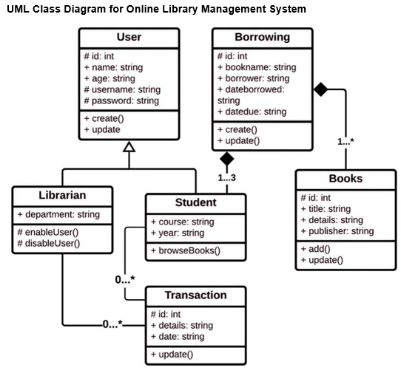
UML CLASS DIAGRAM

Slide 10




Benefits of Implementing the System
Improved
Efficiency
Enhanced
Collaboration
Greater
Accessibility
Automated management processes streamline operations, saving time and effort for library staff and users.
The system facilitates collaboration among users and provides opportunities for sharing resources and knowledge.
Users can access library resources remotely, eliminating geographical barriers and expanding the reach of the library.

Slide 11
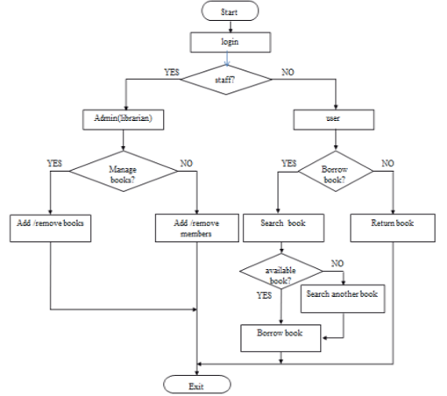
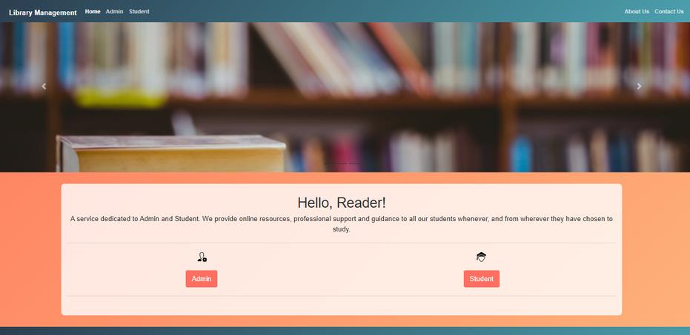
Flowchart
Website prototype

Slide 12


Conclusion
Transforming Library Services
Empowering Users and Institutions
The implementation of the Online Library Management System heralds a transformative shift in the delivery of library services.
Empowering users and institutions with advanced digital capabilities contributes to the advancement of education and knowledge sharing.
Continued Innovation and Adaptation
Embracing continued innovation and adaptation is vital for sustaining the relevance and impact of library services in the digital age.

Slide 13

THANK YOU

